Slide 1




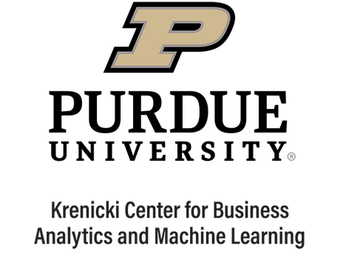
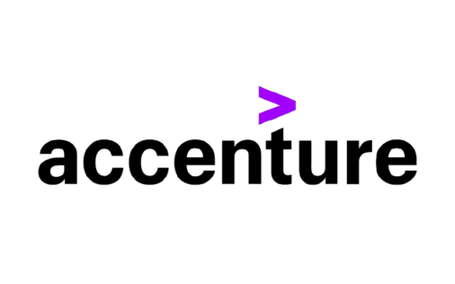
Boiler Strategy Group ​
Goal: Financial Process Transformation​ for a Global Lifestyle Brand
By Tanvi Vijay, Parth Kapila, Ramana Prabhu Sana, Saandiya KPS Mohan

Slide 2
Project Overview
Objective: Transform receivables management processes from human-driven → AI-driven workflows
Focus Areas:
Risk & revenue management processes
Credit accuracy monitoring
KPI reporting automation
Revenue assurance workflows
Target:
Improve efficiency
Reduce manual work
Enable data-driven decision making

Slide 3
Business Problem & Need
Manual AR matching, dispute handling, and risk review delay cash collection and increase operational cost in large enterprises, specifically:
​
High-volume payments require manual remittance investigation and invoice matching.​
Disputes are handled reactively, increasing cycle time and operational overhead.​
Risk segmentation for bad-debt reserves remains judgment-heavy and inconsistent.​
​
Client Challenges:​
Repetitive Manual Matching ​
Reactive Dispute Management​
Subjective Risk Segmentation

Slide 4
Approach
Phase 1 — Process Analysis
Reviewed existing workflow process flows
Identified pain points and inefficiencies (Root Cause Analysis)
Mapped current workflow steps
Phase 2 — AI Solution Design
Behavioral insights agent
Incorrect credit detection agent
KPI reporting automation
Revenue assurance monitoring
Phase 3 — Process Redesign & Evaluation
Shifted steps from manual → AI-driven
Defined impact on human roles
Designed future workflow model
Prototype testing
Performance measurement
Feedback collection

Slide 5
Solution Design
AI Overlay Framework
Defined variables for each process:
What task the AI agent performs
Where it fits in workflow
How process logic changes
Impact on human roles
Level of automation (manual → AI-driven)
Resulting Improvements:
Automated credit validation
Predictive risk monitoring
Real-time KPI tracking
Reduced manual intervention

Slide 6

AI Agents
Accounts Receivable Agent
The goal of the agent is to match and clear incoming payments, reducing manual investigation effort up to 90%​.
Dispute Resolution Agent
The goal of the agent is to scan invoices for errors automatically along with detecting incorrect charges and suggesting fixes.​
Behavioral Insights Agent
The goal of the agent is to analyze historical financial behavior, disputes and exposure patterns to predict late payments and default risk​.
​

Slide 7

Impact & Value
AI agents significantly improve financial process efficiency by automating repetitive tasks.​
​
The system shifts finance roles from manual investigation to strategic oversight and decision making.​
​
Despite automation, human expertise remains essential for:
Handling exceptions
Validating AI recommendations
Critical financial decisions

Slide 8
Thank You

